Slide 1
Virginia Association of School Superintendents Risk Management Event
The STRENGTH you need.
The PARTNERSHIP you expect.
Chris Carey
Administrator

Slide 2
Disclaimer
The information and materials herein are provided for general information purposes only and are not intended to constitute legal or other advice or opinions on any specific matters and are not intended to replace the advice of a qualified attorney.

Slide 3
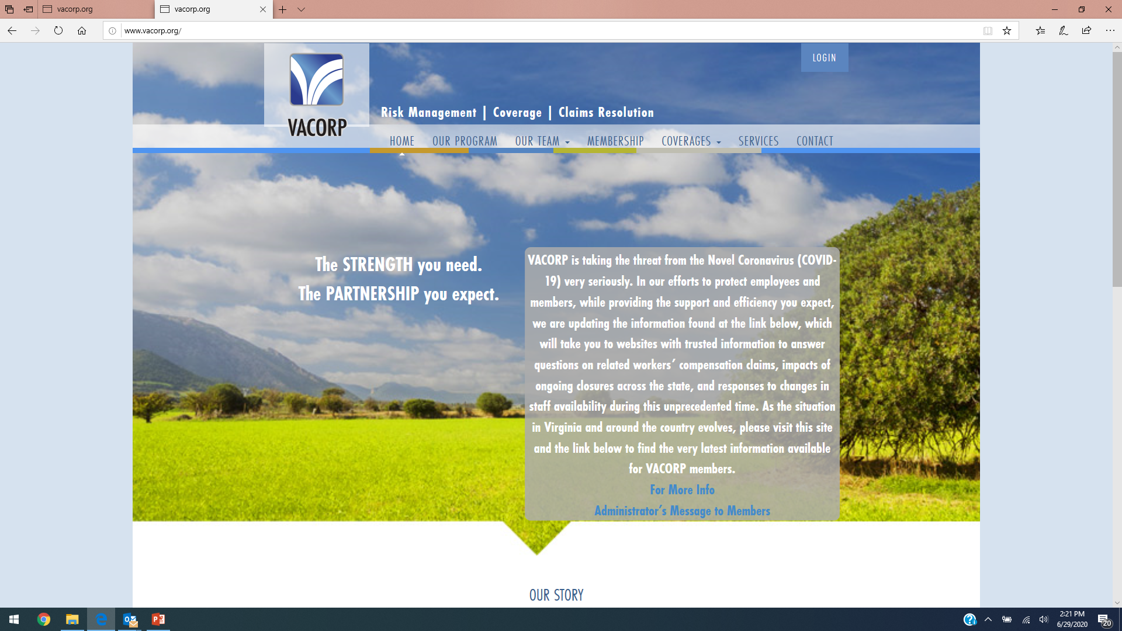
WWW.VACORP.ORG
Notes:
3

Slide 4
Workers’ Compensation
Workers’ Compensation Claims For employees who have been diagnosed with the virus and feel the exposure arose out of and/or was caused by their employment, please submit that claim through your traditional pathway.
For most that will be via Company Nurse, the most efficient way for us to receive information quickly and subsequent to triage by an actual nurse. Members who do not use Company Nurse are strongly encouraged to report the claim via the website as soon as possible.
Please note that a claim for COVID-19 could fall into the area of “Ordinary Disease of Life” as defined under the Virginia Workers’ Compensation Act per VA Code 65.2-401. Generally, such diseases are not considered compensable under the Act.
As the virus continues to spread across the community and the world, and as the broader public is exposed to the virus, the opportunity for general daily exposure outside of work increases. We will take into account all information received as part of the claim and establish a determination for each claim as expediently as possible.
Notes:
4

Slide 5
General Liability
These claims occur from people claiming bodily injury from losses occurring on your premises
These claims would most likely result from individuals claiming they contracted the disease a result of your failure to disinfect the school properly or failures in enforcing social distancing (most likely from transportation)
WHATEVER PROTOCOLS YOU PUT IN WRITING….YOU MUST BE WILLING TO TRAIN AND ENFORCE. IF YOU AREN”T WILLING TO TRAIN AND ENFORCE…DON’T WRITE IT DOWN

Slide 6
Professional Liability
These claims occur from people claiming that they were injured as a result from poor decision-making.
These claims will likely result from people claiming they were harmed as a result of your re-opening plan. These claims will result from people claiming you are opening to quickly AND from people claiming you aren’t opening quickly enough.
It will be in your interest to document the reasoning behind any variances from the guidance provided by the State. Documentation makes it easier for us to provide a defense if a claim occurs.

Slide 7
Department of Labor & Industry
Emergency Regulations
Promulgated under Code Section 16 VAC 25-220
Currently, draft regulation is intended to apply to ALL Virginia employers both Public and Private. This is includes Schools.
Schools are classified as “Medium Risk Employers”
Requirements For All Employers
Required to classify all positions as “Very High”, “High”, “Medium” and “Low” risk for exposure
Train employees on methods to self-monitor
Develop Policies and procedures on how to report a positive test and to report when they have symptoms
Must continue to protect privacy

Slide 8
Department of Labor & Industry
Emergency Regulations - Continued
Requirements For All Employers
Create procedure to prevent positive or “Suspected” positive employees from returning to work.
Work with sub-contractors/suppliers to make sure they communicate positive tests to you and you do the same. Must attempt to notify anyone that could have come in contact within the past 14 days.
Must have a return to work policy for those that have received a positive test or classified as “Suspected” Covid-19 positive. Regulation includes two methods to chose from.
Must have Social Distancing guidelines in place.
Common Areas, Breakrooms and Lunch rooms should be closed or controlled.
Technically, you are supposed to require masks if you have two or more employees in the same vehicle. (Does not appear School Buses were contemplated in this section).

Slide 9
Department of Labor & Industry
Emergency Regulations - Continued
Requirements For All Employers
Technically, it requires all employees to wear masks when they are in circumstances where they can’t social distance.
Has exemptions for medical conditions and religion.
Need to have a disinfection plan in place that includes disinfecting when there has been a positive test.
Technically, you are supposed to disinfect common areas and bathrooms after each day or shift.
You are supposed to provide easy and frequent access to handwashing or hand sanitizing stations.
Notes:
enacted in 1975 and periodically amended
Lack of medical evidence addressing employment related occupation disease.
General Assembly created rebuttable presumptions to benefit certain eligible employees and establish by law, a causal connection between death or disability from certain diseases and the occupation.

Slide 10
Department of Labor & Industry
Emergency Regulations - Continued
Requirements Specific to “Medium” Risk Employers
Facilities are supposed to meet the 62.1 and 62.2 ANSI Standards for heating and Cooling Systems.
Install Physical Barriers where appropriate
Daily Health Screening
Limit non-employee access
Need to have written certification that work site and hazards have been assessed.
Create and Infectious Disease Preparedness and Response Plan – Basically create a plan, appoint a coordinator, Train the coordinator and staff, implement plan.
Create a Contingency Plan
Notes:
The Intertwining of Workers’ Comp and LODA
Concurrent benefits
If just a disability LODA only pays health care costs
If death results, LODA pays a death benefit and continued healthcare for surviving beneficiaries
Different deadlines to file claim

Slide 11
Web-Based Training Courses
Current Available COVID-19 Specific Courses – All courses are 7 to 10 minutes in length. Courses available to VACORP Members, please contact your member services representative if you need assistace.
Course 101 – What you need to know
Course 102 – Preparing your household
Course 103 – Managing Stress and Anxiety
Course 104 – Transitioning to a Remote Workforce
Course 105 – Cleaning and Disinfecting Common Spaces
Course 106 – CDC Guidelines for Using Cloth Dace Masks
Course 107 – Reopening Your Organization

Slide 12
Rest assured, with us, you’re covered.
Reach out, we’re here for you.
Thank You!
^{www.VACORP.org}
1819 Electric Rd, Suite C | Roanoke, VA 24018
Phone: (888) 822-6772 | FAX: (877) 212-8599
Risk Management | Coverage | Claims Resolution

